Slide 1
New Drivers and Trends in SDM
SDM Seminar
Dr. Ray Barghi
Chairman, SPUG

Slide 2
Content
SPUG Overview
New Trends and Drivers
SPUG Initiatives
Latest Trends Utilizing SDM
Summary
Notes:
2

Slide 3
SPUG Overview

Slide 4
Introduction
SPUG is an open forum, founded in 2007, with a growing number of global telecom carriers and service providers
Founders and Executive Sponsors
  Dr. Ray Barghi
  Joachim Horn, CTO, T-Mobile International AG
  Graham Baxter, CTO, 3 UK
  Kathy Walker, CNO, Sprint Nextel
  Iyad Tarazi, VP of Network Development, Sprint Nextel
Vision & Mission
Drive separation of subscriber profile data from application logic
Promote data access interfaces based on open, standard protocols
Develop and maintain a reference architecture and a reference data model
Facilitate verification of applications with subscriber profile data store(s)
Work with a broad base of CSPs, vendors and developers in support of USP and application ecosystem
Notes:
4

Slide 5

























Operator Members (partial list)
Notes:
5

Slide 6
The SPUG Difference
The Only Global Forum focused on the SDM ecosystem
Breaking Network-IT barriers with federated IDM solutions
Bridged the gap between Operators and 3rd Party Developers by opening up the network to Value Added Services
Provided a blueprint for successful SDM deployments and legacy migration
Provided a business case to advance from consolidation to revenue generation
Accelerated SDM Adoption by providing Reference Architecture and Use cases
Notes:
6

Slide 7

Standards Bodies
SPUG members are active in Standards Bodies and share developments in SPUG by providing valuable and timely feedback
SPUG caters to Operators’ aggressive requirements and timelines – and helps get it done with whatever it takes
SPUG acts as the last mile enabling the Operators with practical solutions
NGMN
OMA
TMF
3GPP
Du
Tele fonica
Telstra
Sprint

Slide 8
SPUG Ongoing Initiatives
Reference Architecture 2.0
  With updates and additions to reflect Web 2.0
Open Reference Data Model
  Provide guidelines with a baseline data model that can be customized
Open Multi-App Environment
    Provide an independent test environment for the stakeholders
SPUG Certification
    Perform new technology trials and vendor application evaluations
  IOT Testing and Certification of Applications
  Accelerate growth in the SDM area
Subscriber Data Security and Privacy Framework
    Enhanced, user friendly, Privacy controls
Notes:
8

Slide 9
New Trends and Drivers in SDM

Slide 10
SDM at a glance
SDM Definition
Organizing and utilizing subscriber data to enhance customer experience and generate new revenue.

Slide 11
SDM Ecosystem
Web Apps
IDM
PCRF
Apps
3rd Party Apps
Own Apps(Network & VAS)
New
Legacy
Provisioning
Privacy/Security
Components
Common Data Store
&
Unified Subscriber Profile
Subscriber Intel.
(Analytics)
Billing
Other data stores
App
Developers
Operators
SPUG / Industry Forums
Mobile
Advertisers
Participants
Mobile
Merchants
Developers
Universities
End User
Mobile Vendors
Government

Slide 12
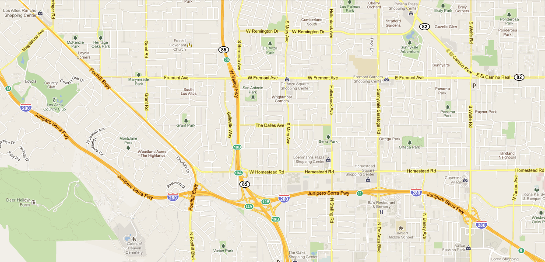
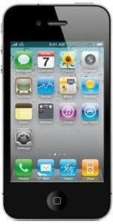
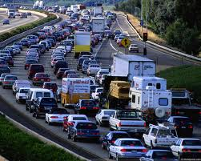
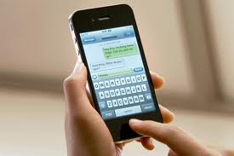





Demo Story Board
Hello, Ray. You are currently experiencing traffic that will continue for another hour. If you want to avoid the traffic, you can take the next exit. Stores at the next exit include Borders and Starbucks, where you can meet friends who are also in the area. If you wish to go to Starbucks, you can order your drink now, by clicking the accept button below, and it will be charged to your bill.
Accept
Decline

Slide 13
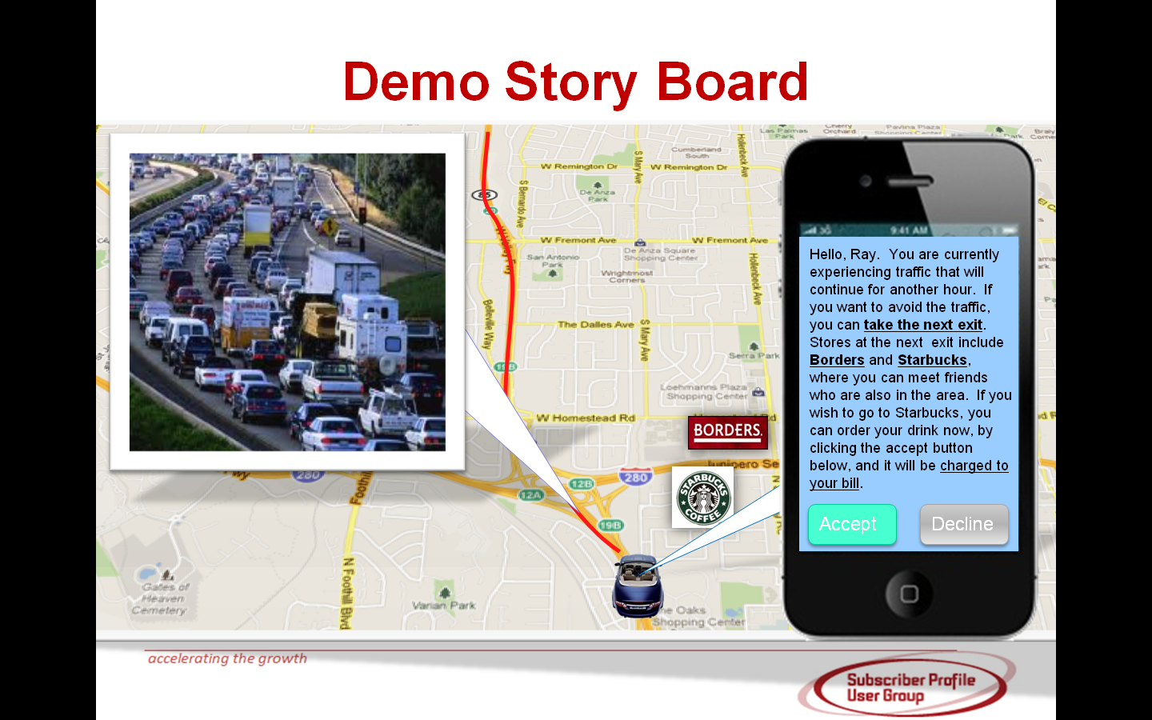

Slide 14



User identity
Confirmation code
Booking order
Suggested coupon
……
User identity
Confirmed order
Confirmed coupon
……

Slide 16

Demo Story Board
Hello, Ray. Your order has been confirmed. Order number: 10320403, confirmation code: 85886263. As a VIP of AT&T,you’ve been granted a coupon of $20.00. Show this message and use the coupon upon your arrival at Starbucks.
Thank you for choosing AT&T and Starbucks!
Hello, Ray. You are currently experiencing traffic that will continue for another hour. If you want to avoid the traffic, you can take the next exit. Stores at the next exit include Borders and Starbucks, where you can meet friends who are also in the area. If you wish to go to Starbucks, you can order your drink now, by clicking the accept button below, and it will be charged to your bill.
Accept
Decline

Slide 17









Demo Story Board
Hello, Ray. Traffic is now cleared, you are free to go. Have a good journey!
Payment Settled
Transaction Complete
confirmation code: 85886263

Slide 18
What’s been achieved here?
Enhanced Customer Experience
Additional revenue for AT&T and Starbucks/Borders
How is this accomplished?

Slide 19








Consolidated Data Store and Legacy Migration
…
Massive Data Analyzer
Common Data Store
Meta Data
GUP
Raw Data
Summary Data
HLR/HSS/AAA
Location
/LBS
Buddy List
Presence
Preference
CRM
Billing
Payment
Other Data Sources
(e.g. Merchants)
HSPA/WIMAX
GSM/UMTS
LTE
IMS/SAE
HSPA/WIMAX
GSM/UMTS
LTE
IMS/SAE

Slide 20




Better Customer Care Improves Customer Loyalty
Query 1 to query N
Databases
Can’t Enjoy GPRS Services
……
Customer Care
Which way brings better user experience?
CDB
One Query Only
Customer Care

Slide 21







Better Knowledge of Subscriber Behavior
Fast analyze, promotion in real time
Customer care center
Flight Service
Shopping Guide
1. flight behavior
2. location information
Hotel Information
4. hotel behavior
1. flight information
3. shopping habit
2. flight delay information
Awareness of user’s environment
3. shopping information
Subscriber Intelligence
CDN
Meta
data
Promotion according to user context, behavior and habits.
4. hotel information
Raw Data
Summary Data
Mobile Network
Subscriber Data Center
Real time information and history information fall together

Slide 22







Information is All Over The Place
Device Information
Behavior Information
Relationship Information
Location Information
Preference Information
Consume Information
Real-time subscriber Profile
Massive Subscriber Data
Traffic Information
Subscriber preference
Subscriber preference
Meta Data
Preference Information
Traffic
Center
Raw Data
Summary Data
Preference Information
Preference Information
Restaurant

Slide 23




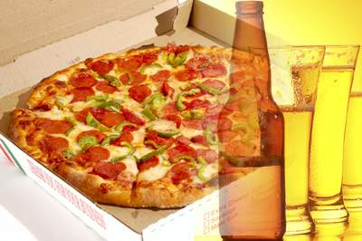

Unified Subscriber Profile and Intelligence (Analytics)
Game
Game information
Movie information
Relation information
Mail application
Mail product to Ray
Credit information
Location data
Profile data
Raw Data
Summary Data
TV information
Game information
Ray likes pizza
Ray likes movie,
now he is on vacation
Ray likes Swatch,
now in the shopping mall
Restaurant
Shopping Mall
Cinema

Slide 24











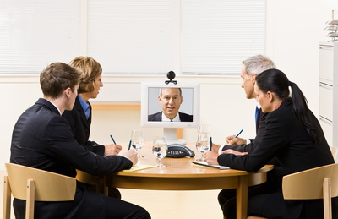
Policy Management
PCRF
Portal
The network is soooooooooo slow!
I have a meeting to go…
Sign up for temporary higher QOS
SGSN/GGSN
Meeting
Application
Crowded
Notes:
Mobile data service policies, including pre-paid, application-based quotas and Fair Use
24

Slide 25




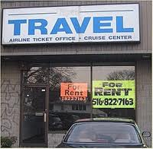


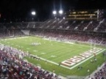




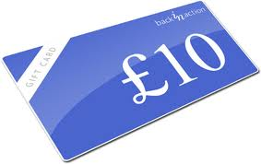



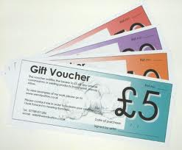



Next Generation Business Policy Management
Within SDM Platform in Operator’s Network
Merchants
Profile
Local VIP
Roamer
Traveler
Profile
Business
Backpacker
Profile
Student
Football Fan
Profile
Elder
Teenage

Slide 26
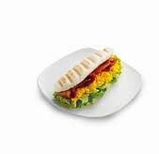
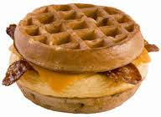




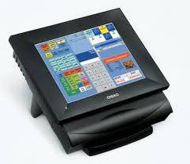


Identity Management and Brokering
$Cashier

Slide 27

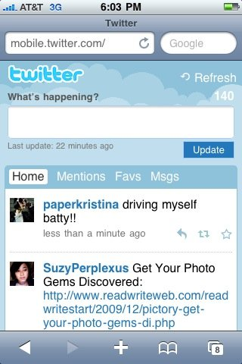

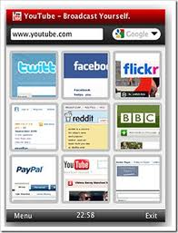
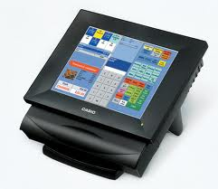

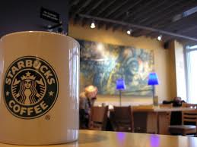
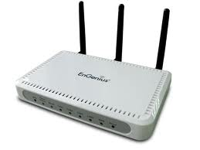




Identity Management and Brokering
GPRS
OFF
$Cashier
Wi-Fi
OFF
ON
Single Sign On
Authenticate

Slide 28

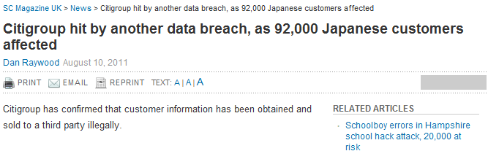


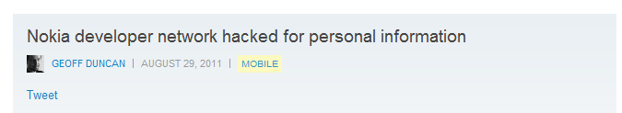
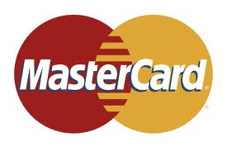



Security Management – Data Security is the Core of all Protections
VPN/IPSEC/SSL
Door Access
Surveillance
Lock
40 million credit card holders were at risk of having their data stolen -- and 200,000 definitely had …
VLAN
Physical Security
77 million user information stolen
Firewall
Anti-Virus
External Network
Internal Network
Information stolen on tens of millions of credit and debit cards…
Authentication
Access Control
Audit
Device
Application
Data
Encrypted Storage
Access Control

Slide 29




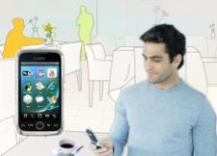




Privacy Issues
Marketing
Privacy Framework
(Bumblebee)
Anonymous Information
Privacy policy disclosure to customer, including the Information We Collect, Why and How We Collect It, And How We Use It
Ray
1
2
Customer Privacy Controls and Choices, Customer can decide who, when, how, their data can be used
Identity
Req
Result
Target Advertisement and Recommendation,
Customer will not be bothered by disinterested information
3
Policy
4
Rewards,
Customer can get some reward for information sharing
Raw Data
Profile
5
Privacy Control Maximization,
For a group of customers, not certain customer, open results filtered, not raw data
(Safeguard)
Data Protection and Security
6
Customer Feedback Loop, and Continuous Improvement
Notes:
29

Slide 30
What is SPUG doing to accelerate this Vision?

Slide 31
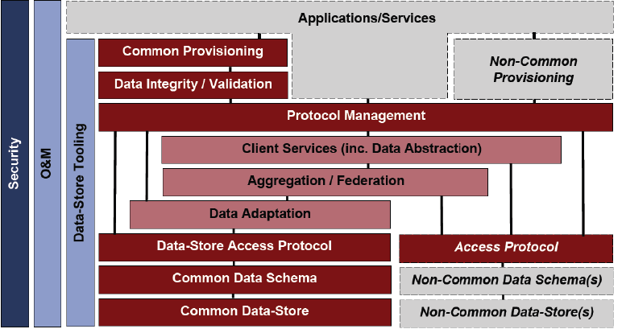
Reference Architecture 2.0
  Update Use Cases, attribute definitions and descriptions
  Update Architecture by expanding the Ecosystem
  Add 3rd Party Developers to the Stakeholders
01/13
05/13
Draft Issue
Ref Arch 2.0 Release
Notes:
31

Slide 32
  Reference Data Model 1.0
    Technology and vendor independent
    Simple, Lean, Flexible and Expandable Model
    With only the most common, required elements
    XML/UML representation
    Operators use a vendor provided Mapping Tool to translate between Ref Data Model and their customized version
Brainstorm
Ref Data Model 1.0
Generate Ideas
Prioritize & Consolidate
Refine, Review & Document
Notes:
32

Slide 33















Multi App Environment & Certification
Operators
Vendor
Feedback (Interest, hot apps)
Sandbox
Identify hot apps
Identify developers
Neutral Certification
CDB
Delegate Certification
API
Docs
Test Lab
Certify (Passed Apps)
Certificate
Support integration of 3rd party apps
Publish the App Integration Roadmap
Developers
Compliance
Conformance
Certification

Slide 34
Subscriber Data Security and Privacy Framework
  Transform business models, overcoming Privacy and Security issues
  Empower the user to decide who, what and when one can access their personal data
  Become trusted brokers of user data and identity
  Provide own and third party personalized services.
Develop the Concept
Review and Refine
Brainstorm
Notes:
34

Slide 35
What are the New Trends we see here utilizing SDM?
Multi-sided Business Model
Social Networking
Targeted Marketing/Advertising
M2M
Cloud Services

Slide 36


Multi-Sided Business Model
CSPs
Billing & Payment
Customer Care
Consumers
Retailers
Enterprises
User Behavior Analysis
Unified Auth.
Ad. Providers
Organizations
Internet SPs
Unified ID
……
Governments
Other Operators
Operator – Telco Capabilities
Service Providers
(Revenue Side 1)
End Users
(Revenue Side 2)

Slide 37








Social Networking
Instant Messenger
  File transfer
  Conversion to SMS
  Universal SN connector
VoIP
One Box
  Video call
  Video streaming
  Blacklist
  Web Email, SMS, MMS, Voice mail
  Message warehouse
Convergent Address Book/
User Profile
Online Storage
Micro-Blog
  File sharing
  Super storage
  Offline download
  SMS notification
  Blog roaming
Telecom
Internet

Slide 38

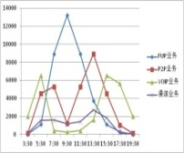



Targeted Marketing/Advertising/Personalized Services/In App Commerce
Location
Presence
Device
QoS
Friend
Preference
…
Profile Information
Ray is in traffic, he likes Coffee and Books, there’s coffee shop nearby……
Real time context-aware
Traffic Information
Cloud analysis
Ad. Information
Targeted group
Smart Decision
Credits management

Slide 39




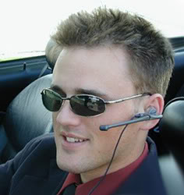
M2M/Smart Home
Open the door？
Yes
No

Slide 40

Cloud Services
SDM
Cloud
SDM Ecosystem
Distributed
Virtualization
Distributed
Parallel
Virtualization
Automation
CT-Oriented Reliability
IT-Oriented Reliability
CT-Oriented O&M
IT-Oriented O&M
SDM: SaaS based on CT-Cloud?

Slide 41
Summary: Why & How SDM
Why SDM?
  Reduce Cost
  Gain Real Time Customer Insight
  Enhance Customer Experience
  Generate New Revenue
  Increase Loyalty and Reduce Churn
How to do it?
  State of Art, Available, Scalable, Fault Tolerant and Resilient Data store
  Develop and Maintain the SDM Ecosystem
  Integrate Key Enablers – Subscriber Intelligence, IDM, Policy etc.
  Utilize Multi sided Business Model
  SPUG Forum – Learn from operators’ experiences and share your own

Slide 42
Contact Information
Dr. Ray Barghi
CMO, SDM Solution, Huawei
Chairman, SPUG
ray.barghi@huawei.com
ray.barghi@spugglobal.com
+1-703-932-7608 (USA)
Kanth Jonnalagadda, PMP
Program Director, SPUG
jkanth@spugonline.com
+91-8008374475 (INDIA)
+1-610-820-0911 (USA)
WWW.SPUGGLOBAL.COM
Notes:
42

